Slide 1



Congress
Sustainability reporting in the EU
SESSION 3: New corporate disclosure regulation, a landmark in sustainable finance?
Patrick de Cambourg, Chair of the EFRAG Sustainability Reporting Board
3 & 4 April 2024, Madrid
Acciona Campus Auditorium

Slide 2
Disclaimer
The views expressed in this presentation are those of the presenter, except where indicated otherwise. EFRAG positions, as approved by the EFRAG SRB, are published as comment letters, discussion or position papers, or in any other form considered appropriate in the circumstances.

Slide 3
In a nutshell ...
The goal is to organise a second pillar of standardised corporate reporting alongside financial reporting on an equal footing and therefore …
… to provide quality sustainability related information to capital markets and other stakeholders in order …
… to avoid green or ESG washing and …
… to foster the creation of a single harmonised and reliable data platform (both in human readable and digital formats).

Slide 4
AGENDA
CSRD & first set of sector agnostic ESRS
ESRS for SMEs: Two Exposure Drafts
Implementation support
EFRAG and the sector work
Interoperability
ESRS for non-EU groups

Slide 5
1. CSRD & first set of sector agnostic ESRS (1/4)
Sustainability reporting in the EU
A robust mandatory legal regime of sustainability reporting under double materiality
CSRD
ESRS
Firstly, sector agnostic, then sector specific
LEVEL 1
Draft ESRS developed by EFRAG
Provided as technical advice to the EC
Adopted as delegated acts by the EC
LEVEL 2

Slide 6
The key features of the CSRD
1. CSRD & first set of sector agnostic ESRS (2/4)
Mandating the use of European Sustainability Reporting Standards (ESRS) developed by EFRAG and adopted by the EC via delegated acts - comprehensive coverage of sustainability matters: E, S & G
A key concept: double materiality (impacts and financial risks/opportunities)
Location and timing of reporting: in the management report, i.e., at the same time as financial statements
Mandatory limited assurance to start with, moving to reasonable assurance by the end of the decade
Both human and machine-readable using European Single Electronic Format (ESEF) from 2025/2025 (timing to be confirmed) – EFRAG tasked to develop the draft XBRL taxonomy
Transposition into national law (by July 2024): focused on some points as harmonisation level is already high

Slide 7
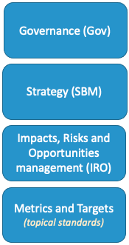
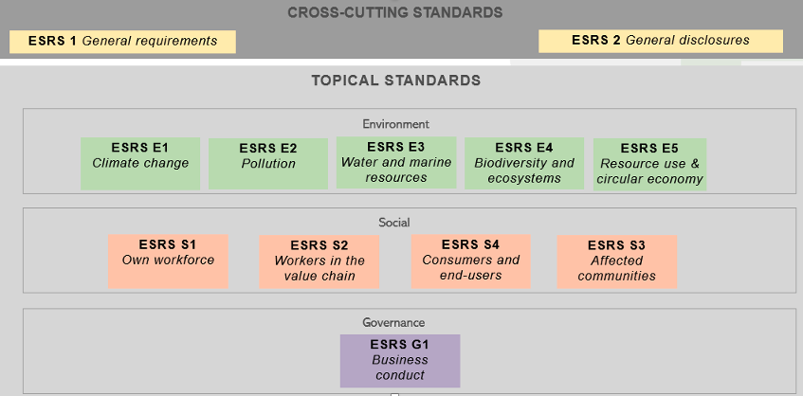
The first set of sector agnostic ESRS
1. CSRD & first set of sector agnostic ESRS (3/4)
4 Reporting areas :
Categories of ESRS Standards for large companies (EU criteria)
  Cross cutting standards
  Topical Standards
  Sector specific standards
+
Other ESRS Standards
  LSME standard (Listed SME)
  VSME (voluntary SME)
Standarisation of reporting whilst creating a platform of sustainability data within the EU
-> SFDR PAIs for financial market participants
-> Art. 8 taxonomy

Slide 8
The pivotal role of the materiality assessment
1. CSRD & first set of sector agnostic ESRS (4/4)
Sustainability statements shall reflect all material impacts, risks and opportunities (IROs): under an objective approach with thresholds. Thus, not all sector agnostic standards may be applicable to an undertaking.
Reporting entity to implement a rigorous materiality assessment process to determine material IROs (inc understanding of its value chain). This will be subject to audit.

Slide 9
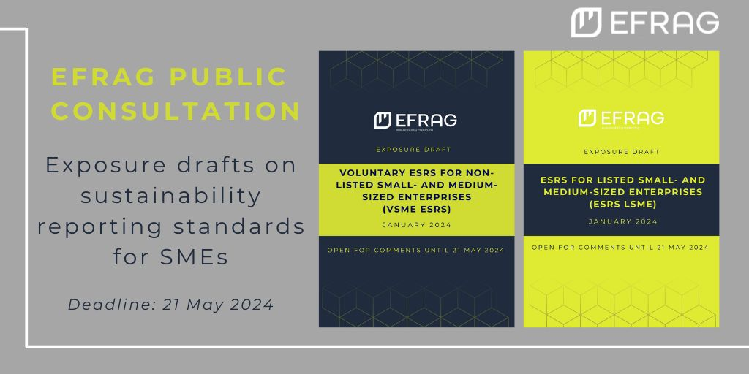
2. ESRS for SMEs: Two Exposure Drafts (1/2)
Exposure drafts for both LSME (for listed SMEs) and the voluntary reporting standard for unlisted SMEs (VSME) was issued on 22 January 2024 with deadline for comments on 21 May 2024
Discussion with CFSS on 17 January 2024
Educational videos issued on 16 February 2024
Public outreach event: 20 February 2024
Work on field tests, outreach events and cost benefit analysis ongoing
Both draft standards to be delivered as technical advice to the EC in December 2024

Slide 10
2. ESRS for SMEs: Two Exposure Drafts (2/2)
Modular approach to maximise proportionality
VSME
SMEs undertakings that have already policies, actions and targets (PAT) in place and to report
Disclose the material matters (from the llist in AR 16 of ESRS 1)
Simplified language (including for materiality)
5 Disclosures
Narrative -PAT Module
Basic Module
Entry level for non listed SMEs
Target for micro-undertakings
Simplified language (No materiality)
12 Disclosures including ESG Topical Metrics
  Simplification: all required BUT whenever it is appropriate ‘IF APPLICABLE’
When SME face questionnaires from business partners
Sustainable Finance datapoints (Table 1 SFDR PAI, EBA Pillar 3, Benchmark Regulation) as proxies for ESG management.
Minimum language simplification achieved
Disclose the material matters (from the llist in AR 16 of ESRS 1)
11 Disclosures
Business Partner Module

Slide 11
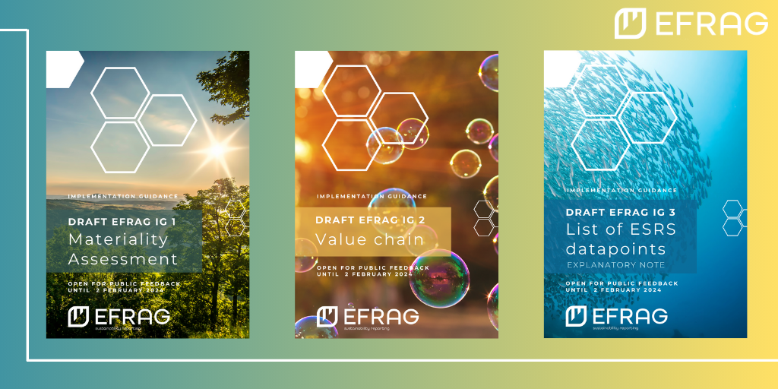
3. Implementation support (1/3)
3 documents issued on 22 December 2023 with a deadline for comments on 2 February 2024, covering:
  Materiality assessment
  Value chain
  Datapoints

Slide 12
IGs pipeline
3. Implementation support (2/3)
Transition plans
ESRS 1 Application Requirements 16 (table of sustainability matters) mapping to Disclosure Requirements
Training Implementation Guidance (IG)
Other IGs
  Pension fund emissions
  Guarantees of origin and other certificates
  Water storage
  Resource use

Slide 13
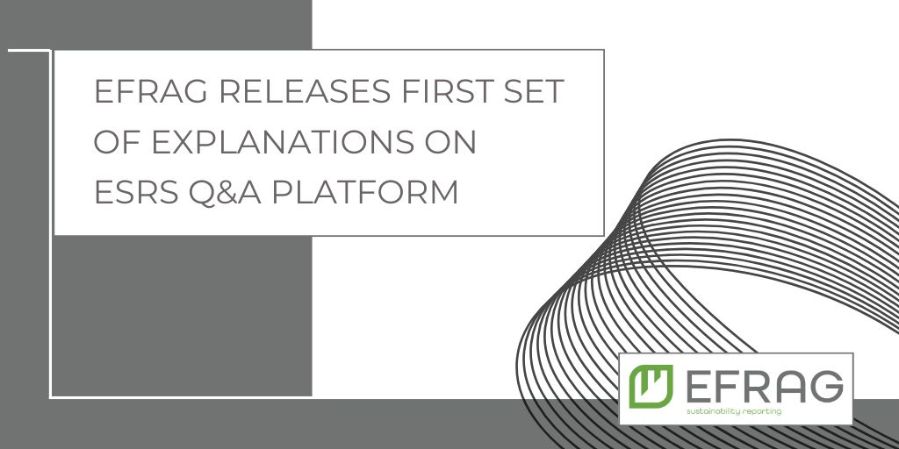
Q&A platform
3. Implementation support (3/3)
First set of Explanations released on 5 February 2024
Second set on 1 March 2024
Contained 12 explanations each
Position as of 11 March 2024: 342 questions received
Classification of 26 still being analysed
Expected outcome:
128 explanations (already being drafted)
22 Implementation Guidance
Remaining questions:
41 not technical in nature
89 already addressed
41 non-conclusive/out of scope

Slide 14
4. EFRAG and the sector work
Eleven workshops on SEC 1 (Standard-setting approach and classification standard) during February 2024
Advisory panels for financial institutions (Banking, Capital Markets and Insurance) announced and kick-off meetings held
SEC 1 and sector EDs on Oil and Gas as well as Mining, Quarrying and Coal Mining available in H2 2024
Sector EDs for Road transport and Textiles, accessories, jewellery and footwear planned to be available in Q1 2025, but depends on resources
Other high-impact sectors: preparation ongoing with SR TEG and SRB discussions in 2025 onwards
V1 of FI sector standards planned for SR TEG discussion in December 2024/January 2025 and ED issuance in H2 2025
Sustainability reporting in the EU

Slide 15



5. Interoperability
To avoid double reporting (key EU objective: no duplication)
Leveraging on the high-level of interoperability achieved in published ESRS
Implementation support material issued jointly (GRI has been issued, IFRS and TNFD is in progress)
Illustration of the correspondence of detailed requirements in ESRS that correspond to the other standard, with clarification of differences in terminology and substance (if any)
Paving the way to digital interoperability
Sustainability reporting in the EU
15

Slide 16
6. ESRS for non-EU groups
Scope A. article 40a(1): Large subsidiaries including unlisted and public interest SME subsidiaries:
  they are in the CSRD scope in their own right
  in addition, information on group level to be provided if net Group turnover in the EU > €150 million
Scope B. article 40a(1): If no subsidiary in scope A, information on group level if a branch generating more than €40 million if net Group turnover in the EU > €150 million
Adoption of separate standards specially for non-EU companies foreseen
Deadline proposed to postpone to June 2026 -> EFRAG to deliver its advice to the EC by November 2025.
The consultation on an Exposure Draft will start in Q4-2024 or Q1-2025 at the latest.
Sustainability reporting in the EU

