Slide 1
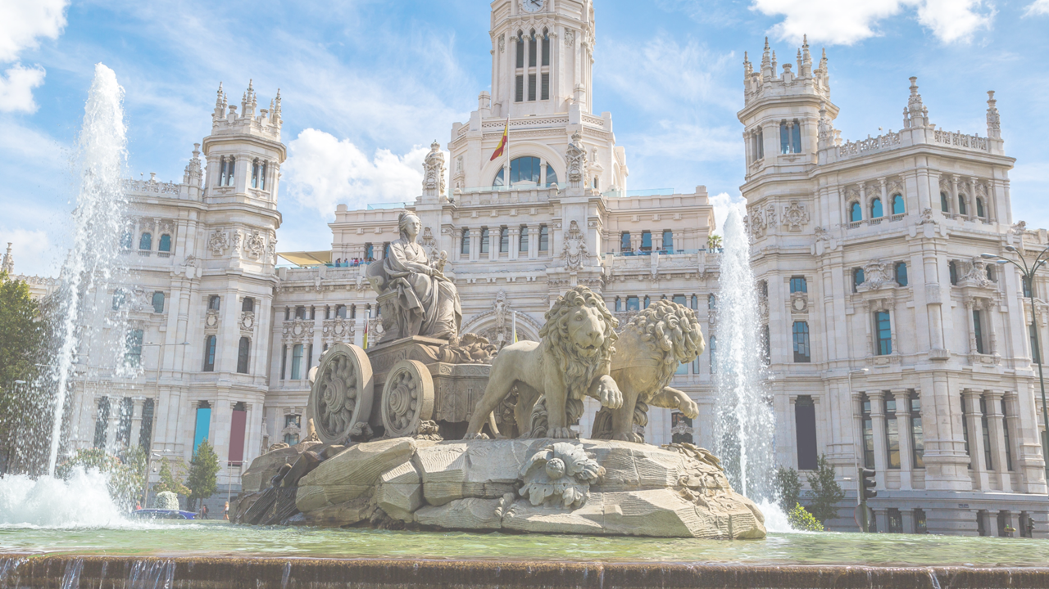


Congress
Innovation across asset classes:
Fixed income
3 & 4 April 2024, Madrid
Acciona Campus Auditorium

Slide 2
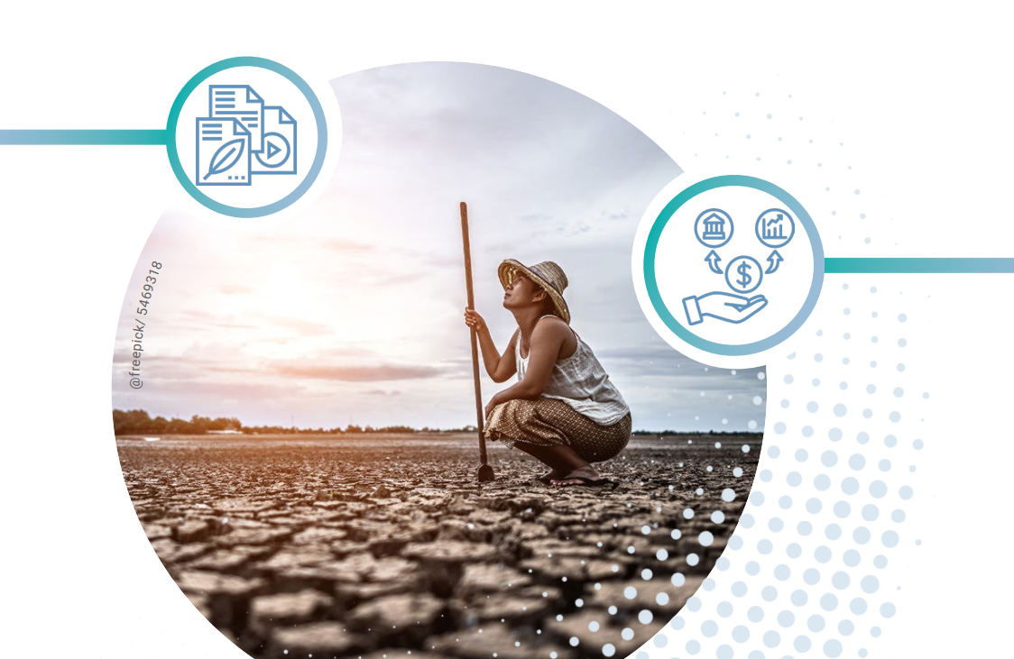
Climate change is hitting us
Rice production is already down 31% in major producer nations (USDA)
India set for 188 days of extreme heat by 2050 (Washington Post)
Singapore could see 4 to 5m sea level rise. (The Straits Times)
“[We are] firmly on track towards an unliveable world. Major cities under water. Unprecedented heatwaves. Terrifying storms. Widespread water shortages.”
UN Secretary-General António Guterres’

Slide 3
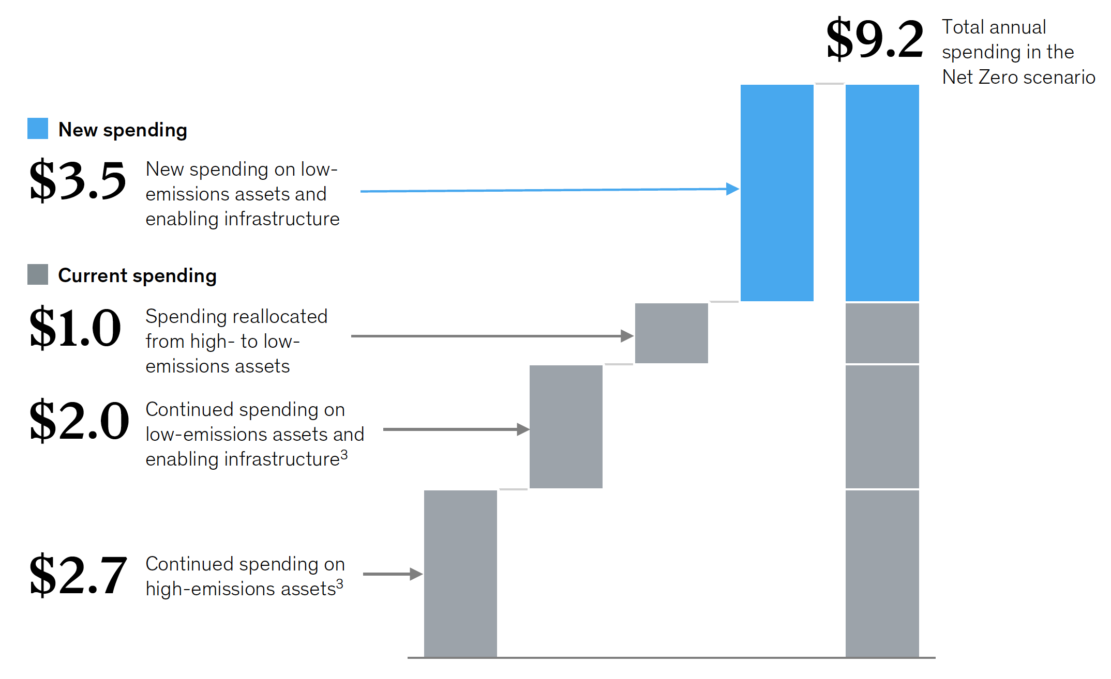
Trillions p.a. of mitigation investment needed
McKinsey’s
January 2022

Slide 4
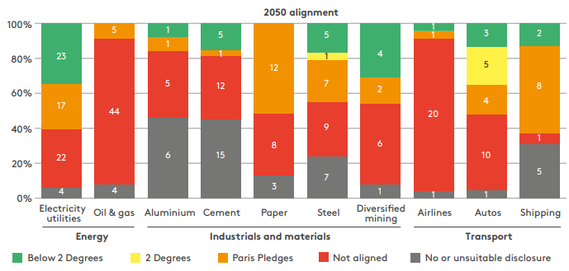
Most sectors must undergo major transformation
Notes:
To operate in a lower carbon economy, most sectors must undergo a major transformation
The graph shows the major sectors alignment with the Paris Agreement aim for net zero by 2050
The first column shows the transformation is well underway in the power generation sector (shown as electricity utilities)
Can see that most sectors are not aligned with the goals of the Paris Agreement and will have a lot of work to do

Slide 5
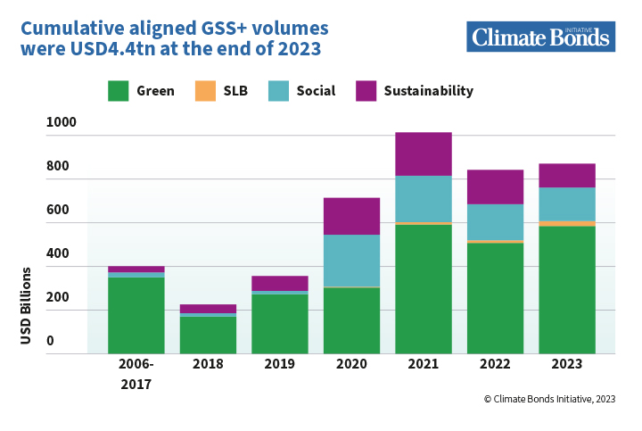
Cumulative GSS outstanding at USD4.4tn
2016 2017
Notes:
MAIN TALKING POINTS:
a) Overview of the GSS+ market development.
SUGGESTED/GUIDING ELEMENTS:
a) Overview of the GSS+ market development.
- Read through key elements of the graphic.
- Highlight the evolution and growth of the GSS+ bond market in the last decade.
- Recall key players in the GSS+ bond market.
USEFUL TEXT, LINKS AND MATERIALS:
10 years ago there really wasn't much to say about the green bond market.
The rise of interest and pressure came particularly from Nordic pension and sovereign wealth funds and from Europe, who were assessing the non-financial risks against their portfolios. Hard-to-abate sectors were also being questioned about their rather limited transition to more sustainable practices and business models.
There was an appetite for instruments and methodologies permitting the finance sector to adopt and invest in more sustainable practices (e.g. IFC, Asian Development Bank, etc.)
2007/2008 - The European Investment Bank (EIB) issued an equity index-linked bond in 2007, which became the first fixed income product among socially responsible investments. This “Climate Awareness Bond” structure was used to fund renewable energy and energy efficiency projects. Afterwards, the World Bank became first in the world to issue a labelled “green bond” in 2008, which followed a conventional “plain vanilla” bond structure, contrary to EIB’s equity-linked Climate Awareness Bond.
The Climate Bonds initiative saw the light in 2010 and put in place the Climate Bonds Framework to help guide the market and a) to provide assurance for investors about the environmental integrity of climate bonds, 2) to provide governments with an easy-to-use tool to preference investments for climate change solutions and 3) to foster growth for investor demand in climate-related investment opportunities.
In 2013 the green bond market started to take off, we had the initial issuance benchmark of IFC in early 2014 and by the end of that same year more corporates were interested in the market.
In 2014 the Green Bond Principles of ICMA were launched which is another very important part of the market infra-structure to help and guide the market in the right direction.
The market has expanded into other regions out of the European Community and the US. For instance China whose interest in the Green Bond Market began in 2015 when the Peoples Bank of China inquire about the market and its opportunities. China commenced the development of its guidelines for domestic markets. By 2016 China went from 0 to 40 Billions (USD) on green bond issuance. China is one of the top issuers of green bonds.
China’s internal processes contributed to raise awareness in other regions and countries, for instance more and more countries around the world are issuing sovereign bonds while developing national or regional market infrastructure to scale up green bonds (Europe, ASEAN, etc. ).
2018/2019/2020
Other parts of the world are currently developing or exploring the possibility to develop their own infrastructure, for instance Indonesia, Malaysia and Thailand have been discussing about local taxonomies. Colombia is also developing a national taxonomy looking to the EU taxonomy as guidance.
2020 - $1Trillion Mark Reached in Global Cumulative Green Issuance
Climate Bonds Sustainable Debt Global State of the Market 2021: https://www.climatebonds.net/resources/reports/sustainable-debt-global-state-market-2021
Climate Bonds Sustainable Debt Market Summary Q1 2022: https://www.climatebonds.net/files/reports/cbi_susdebtsum_q12022_01f.pdf

Slide 6
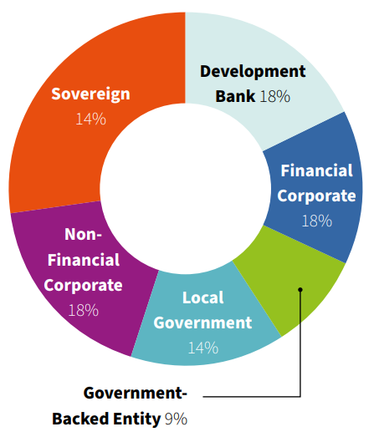
Diversification among issuer types
Notes:
MAIN TALKING POINTS:
a) Overview of the GSS+ market development.
SUGGESTED/GUIDING ELEMENTS:
a) Overview of the GSS+ market development.
- Read through key elements of the graphic.
- Highlight the evolution and growth of the GSS+ bond market in the last decade.
- Recall key players in the GSS+ bond market.
USEFUL TEXT, LINKS AND MATERIALS:
10 years ago there really wasn't much to say about the green bond market.
The rise of interest and pressure came particularly from Nordic pension and sovereign wealth funds and from Europe, who were assessing the non-financial risks against their portfolios. Hard-to-abate sectors were also being questioned about their rather limited transition to more sustainable practices and business models.
There was an appetite for instruments and methodologies permitting the finance sector to adopt and invest in more sustainable practices (e.g. IFC, Asian Development Bank, etc.)
2007/2008 - The European Investment Bank (EIB) issued an equity index-linked bond in 2007, which became the first fixed income product among socially responsible investments. This “Climate Awareness Bond” structure was used to fund renewable energy and energy efficiency projects. Afterwards, the World Bank became first in the world to issue a labelled “green bond” in 2008, which followed a conventional “plain vanilla” bond structure, contrary to EIB’s equity-linked Climate Awareness Bond.
The Climate Bonds initiative saw the light in 2010 and put in place the Climate Bonds Framework to help guide the market and a) to provide assurance for investors about the environmental integrity of climate bonds, 2) to provide governments with an easy-to-use tool to preference investments for climate change solutions and 3) to foster growth for investor demand in climate-related investment opportunities.
In 2013 the green bond market started to take off, we had the initial issuance benchmark of IFC in early 2014 and by the end of that same year more corporates were interested in the market.
In 2014 the Green Bond Principles of ICMA were launched which is another very important part of the market infra-structure to help and guide the market in the right direction.
The market has expanded into other regions out of the European Community and the US. For instance China whose interest in the Green Bond Market began in 2015 when the Peoples Bank of China inquire about the market and its opportunities. China commenced the development of its guidelines for domestic markets. By 2016 China went from 0 to 40 Billions (USD) on green bond issuance. China is one of the top issuers of green bonds.
China’s internal processes contributed to raise awareness in other regions and countries, for instance more and more countries around the world are issuing sovereign bonds while developing national or regional market infrastructure to scale up green bonds (Europe, ASEAN, etc. ).
2018/2019/2020
Other parts of the world are currently developing or exploring the possibility to develop their own infrastructure, for instance Indonesia, Malaysia and Thailand have been discussing about local taxonomies. Colombia is also developing a national taxonomy looking to the EU taxonomy as guidance.
2020 - $1Trillion Mark Reached in Global Cumulative Green Issuance
Climate Bonds Sustainable Debt Global State of the Market 2021: https://www.climatebonds.net/resources/reports/sustainable-debt-global-state-market-2021
Climate Bonds Sustainable Debt Market Summary Q1 2022: https://www.climatebonds.net/files/reports/cbi_susdebtsum_q12022_01f.pdf

Slide 7
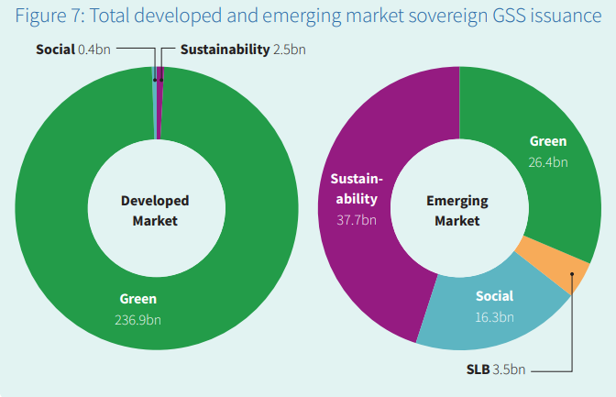
Challenges to Green Bonds in Emerging Markets
Differing finance needs in EMs
=> Climate resilience taxonomy
Lower credit ratings & higher costs of debt
=> Credit & risk support
Existing debt burdens
=> Debt-for-nature swaps
Notes:
98% respondents said green bond attracted new investors

Slide 8
Market growth can be expected to accelerate
State action US IRA
China RE, H2, EVs
EU SFAC etc
Japan Asia GX Consortium
2. Investor belief in economic shift to green Energy
Manufacturing
Minerals
3. Turning NDCs into Transition Opportunity Plans
E.g. Japan Green Transformation Plan

Slide 9
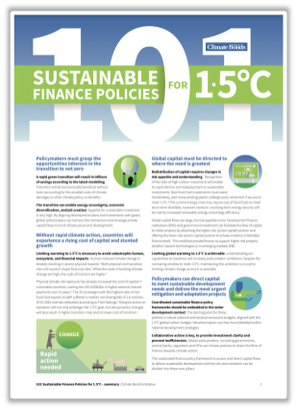
Enabling next steps
1. Clarity on eligibility: taxonomies
2. Demonstration sovereign issuance (50 so far and growing)
3. Incentives
  Sovereign-to-sovereign green guarantees
  Preferential tax and regulatory treatment
  (e.g. Hungary lower capital requirements)
    Risk sharing/de-risking mechanisms by DFIs
    e.g., guarantees, subordinated lending, grants,
    capacity building
www.climatebonds.net/publications.html

